Slide 1
FFT Analysis in Modular Hearing Aid

Slide 2

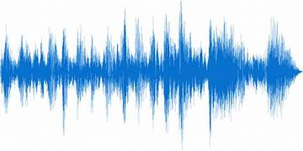
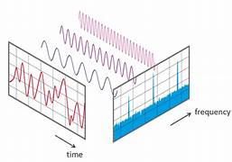
Step-by-step Processing
Read .wav audio file
Display waveform
Apply FFT
Extract speech band
Compare before & after WDRC

Slide 3
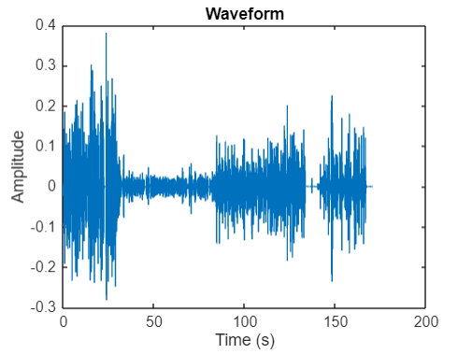
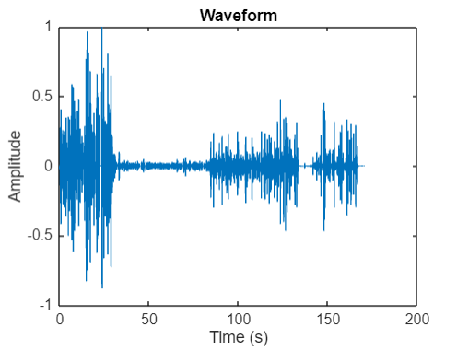
Spectrum of audio
t = (0:length(x)-1)/Fs;
plot(t, x);
xlabel('Time (s)');
ylabel('Amplitude');
title('Waveform');

Slide 4
What is FFT? Why use it?
FFT (Fast Fourier Transform) is a fast method to convert signals from the time domain to the frequency domain. It helps reveal the frequency components of a signal.
It helps reveal the frequency components of a signal.
N = length(x);
X = fft(x);
f = Fs*(0:N/2-1)/N;
magnitude = abs(X(1:N/2));
plot(f, magnitude);
xlabel('Frequency (Hz)');
ylabel('Magnitude');
title('Frequency Spectrum');

Slide 5
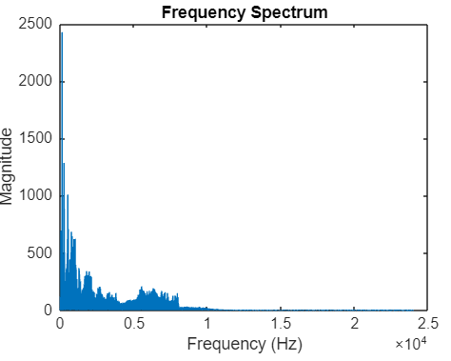
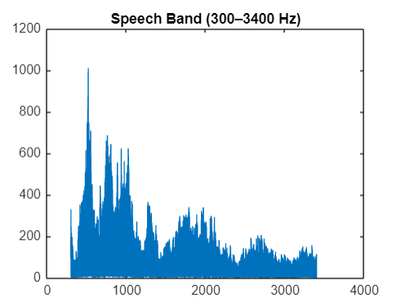
Focus on 300-3400 Hz Band
This range contains most of the important information in human speech.
Includes key formants and phonemes essential for speech recognition.
Enhances speech clarity and intelligibility for hearing aid users.
Eliminates unnecessary frequencies, reducing noise and saving data.
It’s the standard speech bandwidth used in telecommunication and hearing devices.

Slide 6

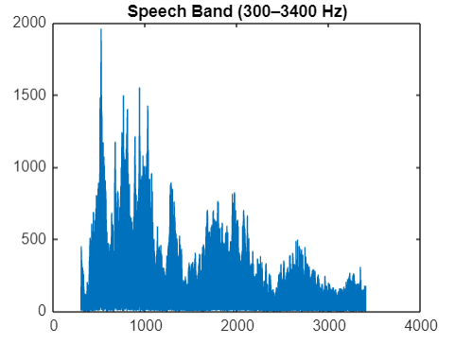
Before and After compression
Before WDRC:
The magnitude of low-frequency components (~300–1000 Hz) is noticeably high.
The energy distribution is fairly uniform from 300 Hz to nearly 3400 Hz.
Distinct frequency peaks are visible, reflecting the original speech signal.
After WDRC:
The low-frequency components are compressed, with the magnitude significantly reduced compared to before.
The energy range is more evenly distributed, helping to balance the frequency bands.
Some high magnitude peaks have been adjusted downwards to prevent discomfort for hearing-impaired listeners.

Slide 7
Conclusion and Significance
The WDRC (Wide Dynamic Range Compression) filter reduces the amplitude of strong frequency components and amplifies weaker ones, resulting in a more balanced spectrum within the 300–3400 Hz speech band.
This adjustment aligns with the goal of hearing aids: enhancing speech clarity without causing distortion or excessive loudness.

Slide 8
THANK YOU !

